Slide 1

Constitution & Bylaws Amendments Workshop
January 20, 2026
Linda Squarzolo
Ontario Provincial CWL
Past President

Slide 2
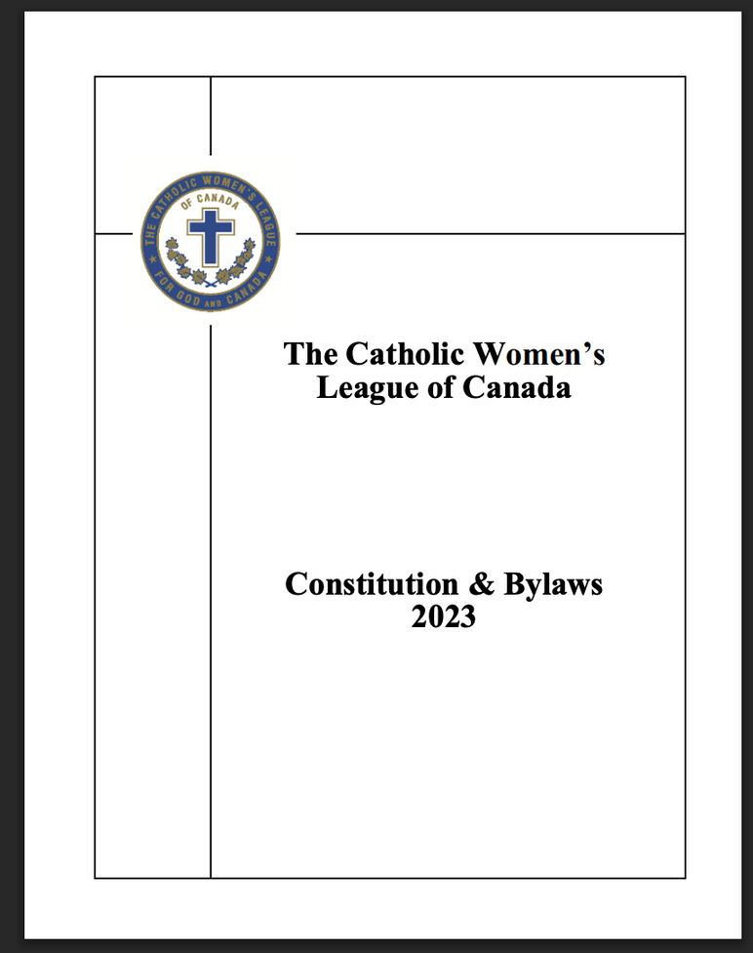
Welcome & Introduction

Slide 3

Agenda
Welcome
Opening Prayer
Land Acknowledgement
Introduction of the Topic
Viewing and Discussing the Proposed Amendments
Conducting the Instructed Vote in Parish Meetings
Sharing the Results
Questions
Closing Prayer
Notes:
AGENDA
Welcome
Opening Prayer
Land Acknowledgement
Introduction of the Topic
Viewing and Discussing the Proposed Amendments
Conducting the Instructed Vote in Parish Meetings
Sharing the Results
Questions
Closing Prayer

Slide 4

Opening Prayer
Dear Lord and Father,
You promise us, that where two or three are gathered, you are there in their midst.
Lord, we welcome you among us today
and celebrate the gift of life that you have lavished upon each one of us.
We ask that you open our ears so that we may hear your voice.
Open our minds so we may receive your eternal wisdom.
Open our spirits so that we may know your leading and guidance.
And open our hearts so that we may receive your wonderful love.
We ask all this in the glorious name of Jesus.
Amen
Notes:
OPENING PRAYER
Dear Lord and Father,
You promise us, that where two or three are gathered, you are there in their midst.
Lord, we welcome you among us today and celebrate the gift of life that you have lavished upon each one of us.
We ask that you open our ears so that we may hear your voice.
Open our minds so we may receive your eternal wisdom.
Open our spirits so that we may know your leading and guidance.
And open our hearts so that we may receive your wonderful love.
We ask all this in the glorious name of Jesus.
Amen.

Slide 5

Land Acknowledgement

Slide 6

Introduction of the Topic
Scheduling the Vote
Notice of Motion
Quorum (10%)
Notes:
Introduction of the Topic
Scheduling the Vote
Notice of Motion
Quorum (10%)

Slide 7

Proposed Amendment #1
To Amend Part III, Section 1
Notes:
Proposed Amendment #1
To amend Part III, Section 1
The crest, as designed and adopted in 1922, shall be the cross, symbolic of faith, surmounting 13 maple leaves, symbolic of the provinces of Canada and three territories, with the words “THE CATHOLIC WOMEN’S LEAGUE OF CANADA” enclosed in an unbroken circle, symbolic of constant service to God and Canada.
The colours of the crest shall be blue, chosen for Our Lady, and the papal colours, white and gold.

Slide 8
Proposed Amendment #2
To Amend Part IX
Notes:
Proposed Amendment #2
To Amend Part IX
To replace (a)(i)
The spiritual advisor. In cooperation with the chairperson of faith (remove spiritual development), shall provide advice and guidance for the spiritual program. (Part VI)

Slide 9
Proposed Amendment #3
Part XIV, Meetings & Quorums
Section 6: Expenses for Voting Delegates
Notes:
Proposed Amendment #3
Part XIV, Meetings and Quorums
Section 6: Expenses for Voting Delegates
(d) At national level, the national treasury shall pay:
(ii) transportation expenses and registration fees for honorary life members to attend the annual national meeting of members

Slide 10
Proposed Amendment #4
Part XIV, Section 9:
Meetings & Quorums
Notes:
Proposed Amendment #4
Part XIV Section 9: due Notice
Notice of the date, time and place of a meeting of members shall be given to each member entitled to vote at the meeting as follows:

Slide 11
Proposed Amendment #5
Part X: Representation at Annual Meetings of Members
Section 1: Delegates
Notes:
Proposed Amendment #5
Part X: Representation at Annual Meetings of Members
Section 1: delegates
(b) Accredited Delegates
(i) Each parish council in the diocese concerned may appoint (remove send) TWO accredited delegates to the diocesan annual meeting of members and ONE accredited delegate to the annual provincial meeting of members.
(ii) Each diocesan council in the province concerned may appoint (remove send)
TWO accredited delegates to the annual provincial meeting of members and TWO accredited delegates to the national annual meeting of members.
(iii) Each provincial council may appoint (remove send) TWO accredited delegates to the annual national meeting of members.

Slide 12
Proposed Amendment #6
Part XVI: Eligibility, Nominations
and Elections
Section 2: Term of Office
Notes:
Proposed Amendment #6
Part XVI: Eligibility, Nominations and Elections
Section 2: Term of Office
(b) An elected or appointed officer shall serve but not exceed one full term in the same office except the chairpersons and treasurers (secretary-treasurer at national level) who may be elected to a second consecutive term.
A chairperson shall be given a different standing committee during each term (remove in her second consecutive).
A treasurer may serve a total of two terms only in this position.

Slide 13
Proposed Amendment #7
Part XVII: Finance
Section 2: Financial Projects
Notes:
Proposed Amendment #7
Part XVII: Finance
Section 2: Financial Projects
(a) At parish level, all financial projects, shall be approved by the members at a council meeting. (remove in consultation with the spiritual advisor)

Slide 14
Proposed Amendment #8
Part XX: Amendment of
Constitution & Bylaws
Notes:
Proposed Amendment #8
Part XX: Amendment of Constitution & Bylaws
(a) The amendments committee shall be composed of the national past president as chairperson, the national president, the national vice-president and other members as required, appointed by the national president.

Slide 15
Proposed Amendment #9
Part XI: Officers
Section 4: Vacancies
at Any Level of the League
Notes:
Proposed Amendment #9
Part XI: Officers
Section 4: vacancies at Any Level of the League
(c)In the event of a vacancy in the office of vice-president during her term, the secretary shall perform the duties of the vice-president until the next election.
She shall not be appointed to the office of vice-president nor assume the office of president.
(d) in the event of a vacancy in the office of vice-president after an election is held, an “acting” vice-president may be appointed by the president in consultation with the executive and the spiritual advisor.
The “acting” vice-president shall perform the duties of the vice-president until the next election. She shall not automatically move to the office of president at the time of the next election.
She may be nominated and elected to the position of president as long as she meets the eligibility criteria and has not held the office of president on that council before.
(e) In the event of a vacancy in any other office than president or vice-president, a member shall be appointed by the president in consultation with the executive and the spiritual advisor and shall serve until the next election.

Slide 16
Proposed Amendment #10
Part XVI: Eligibility, Nominations
& Elections
Section 5: Election of Officers
Notes:
Proposed Amendment #10
Part XVI: Eligibility, Nominations and Elections
Section 5: Election of Officers
(e) Any office, other than the offices of president and vice-president, left vacant following the election shall be filled from those eligible for nomination to office in that council. In special cases, an “acting” president or “acting” vice-president may be appointed by the executive in consultation with the spiritual advisor.

Slide 17
Procedures at Parish Level
Held at a regular CWL meeting 30 days before the diocesan convention
Count the number of members in attendance.
Calculate what the number of yes votes are required for morethan 2/3
Team: PresidentScrutineers Secretary
Deal with each amendment separately. Allow for discussion. Take the vote.
Every parish CWL member can vote, including the president.
Count the Vote: 2/3 of the members voted in favour, it is a yes vote.
If less than 2/3 voted in favour, it is a no vote.
Notes:
Procedures at Parish Level
Held at a regular CWL meeting 30 days before the diocesan convention
Count the number of members in attendance.
Calculate what the number of yes votes are required for more than 2/3
Team: President Scrutineers Secretary
Deal with each amendment separately. Allow for discussion. Take the vote.
Every parish CWL member can vote, including the president.
Count the Vote: 2/3 of the members voted in favour, it is a yes vote.
If less than 2/3 voted in favour, it is a no vote.

Slide 18
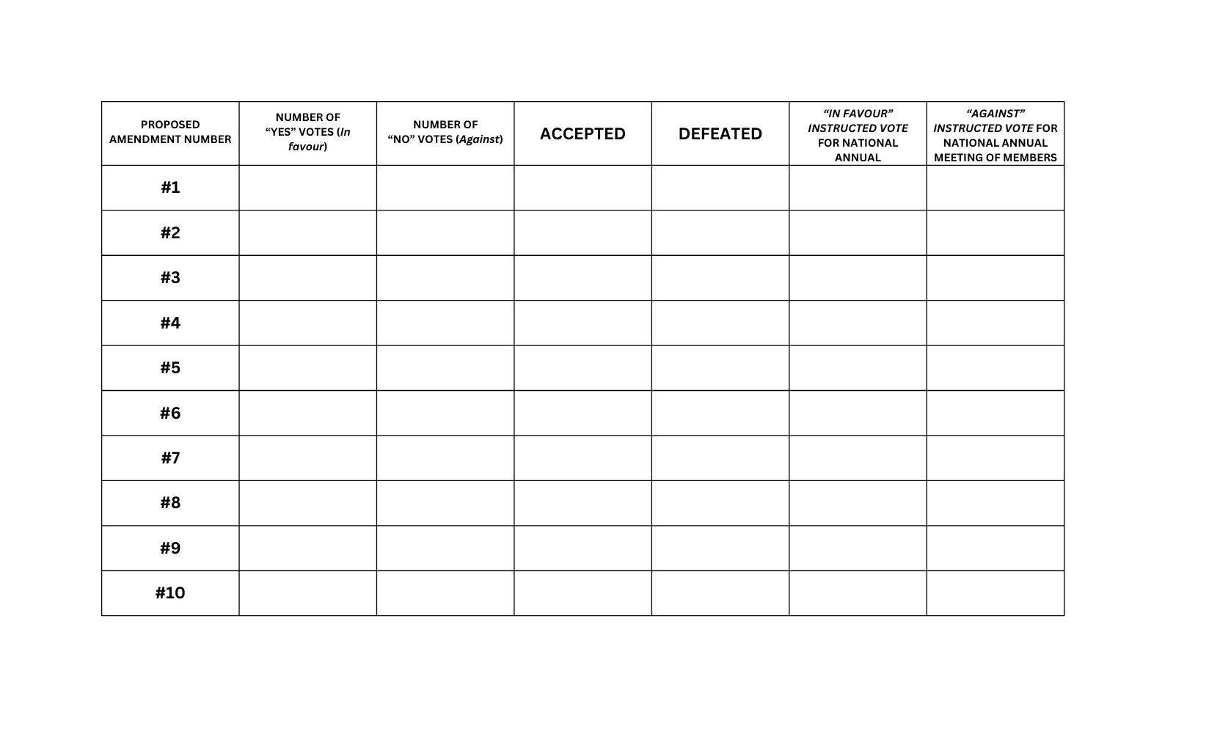
Constitution & Bylaws Proposed Amendment Vote Record Form
RECORD OF PROVINCIAL VOTES ON PROPOSALS 2026
Name of Council: _________________________________________
Date of meeting: _________________________________________
Number of voting delegates present: _________________Number of votes needed for 2/3*:
*Number of voting delegates present for the votes x 2/3 or number of voting delegates present for the votes x .667 or number of voting delegates present for the votes x 66.7%
Notes:
CONSTITUTION & BYLAWS PROPOSED AMENDMENT VOTE RECORD FORM
RECORD OF PROVINCIAL VOTES ON PROPOSALS 2026
Name of Council:
Date of meeting:
Number of voting delegates present:
Number of votes needed for 2/3*:

Slide 19

Additional Copies
For diocesan convention
For diocesan president
For national office
Notes:
Additional Copies
For diocesan convention
For diocesan president
For national office

Slide 20

Questions
Notes:
Questions

Slide 21

Closing Prayer
As we close this meeting, Lord, we thank you for our sisters in the League.
Bless each person gathered here today, who gives her time and talent in your ministry.
Let your hand of protection be on them always.
Let all that we do be for your glory.
Amen
Our Lady of Good Counsel, pray for us. Amen.
Notes:
As we close this meeting, Lord, we thank you for our sisters in the League.
Bless each person gathered here today, who gives her time and talent in your ministry.
Let your hand of protection be on them always.
Let all that we do be for your glory.
Amen
Our Lady of Good Counsel, pray for us. Amen.

